Slide 1
Aptive Data Insights & Heatmaps By ADAlytix
03/07/2019

Slide 2
Agenda
Approach 1
Data Quality & Summary
Approach 2
Business Model & Problem Definition
Data Preparation Approach
RFM Analysis
Heatmaps & Bubble Charts
Charts & Insights
EDA & Insights
Customer Churn & Profitability
Modeling strategies: Next Steps
Modeling results

Slide 3
Data Quality & Summary
4 cities – Dallas, Salt Lake city, Washington DC, Houston; 546 zips; 97,161 customers
Demographic variables at zip level; Many customers in a zip
Avg tenure and Average Contract Value of a customer are of prime importance
Data Quality issues
Some customers had missing demographic data. Imputed with customers from same zip.
Some files have zip codes other than the city for which it contains data. For example; 75007,75010 in Carrolton but present in Dallas file. 75052, 75054 present in Grand Prairie but present in Dallas file. 77584 in Pearland but present in

Slide 4
Data Preparation Approach
Finding zips which has substantial number of customers
Concatenating all the 4 cities data
Creating Correct Tenure (in years) for inactive customers based on #services
(i/5)*365 if i<= 5 else 365+((i-5)/4)*365; i = services_completed
Total Revenue = Avg Contract Value * Correct Tenure
Removing Nulls with forward fill inside each zip group for missing demographic data
Interest variables averaged for all customers in zip

Slide 5
Feature Engineering
1
Excellent : P(ACV) > 80 & P(AT) > 80
Good : 50 < P(ACV) & 50 < P(AT) minus 1
Average: 20 < P(AT) & 20 < P(AT) minus 1 & 2
Below Average: 20 < P(ACV) & 20 < P(AT) minus 1,2 & 3
Poor : P(ACV) < 20 & P(AT) < 20
P – percentile across all the data points
ACV – Avg Contract Value
AT – Average Tenure
Avg
Tenure
4
2
3
5
4
Avg Contract Value

Slide 6
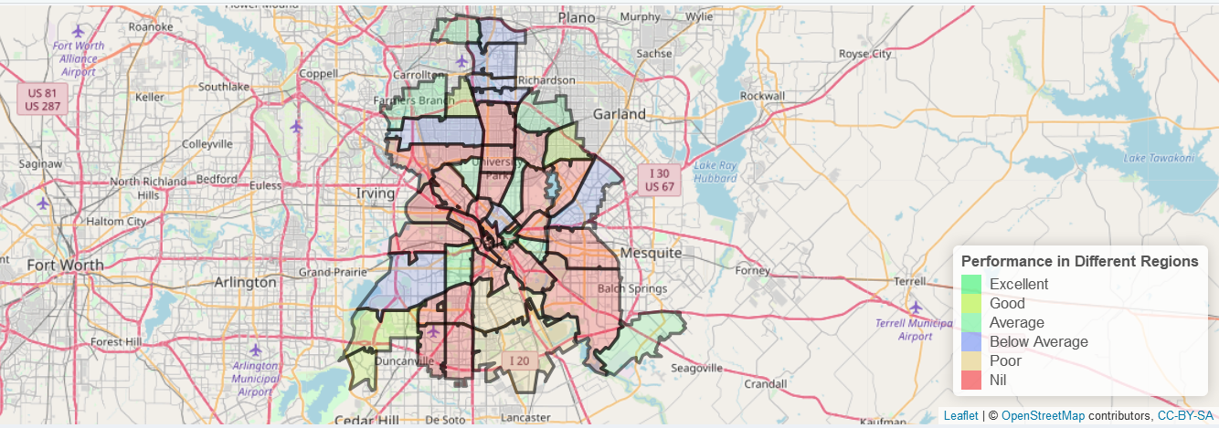
Heatmap & Bubble Charts
Spatial Polygon DataFrames for zip boundaries – available from US gov; used Rgdal library
Leaflet library for interactivity on map
Plotly for scatter and 3D Bubble charts

Slide 7
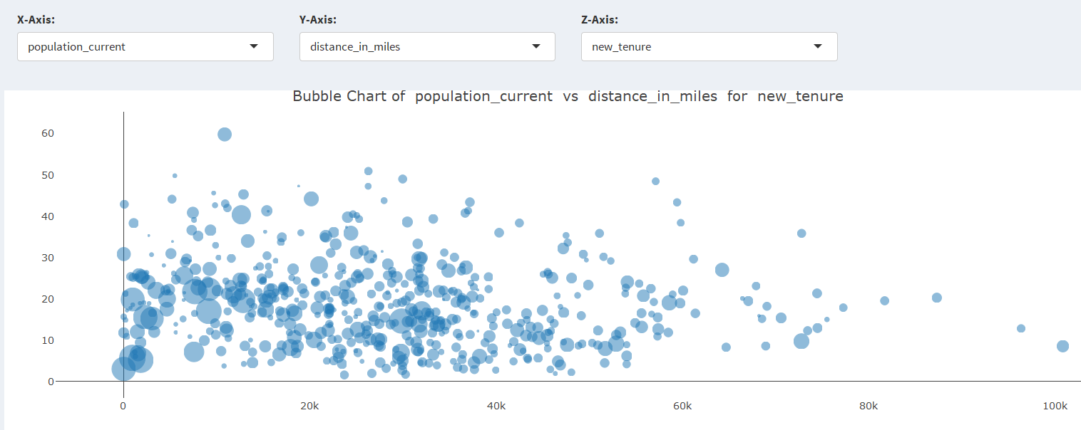
Heatmap & Bubble Charts

Slide 8
Heatmap & Bubble Charts
Demo

Slide 9
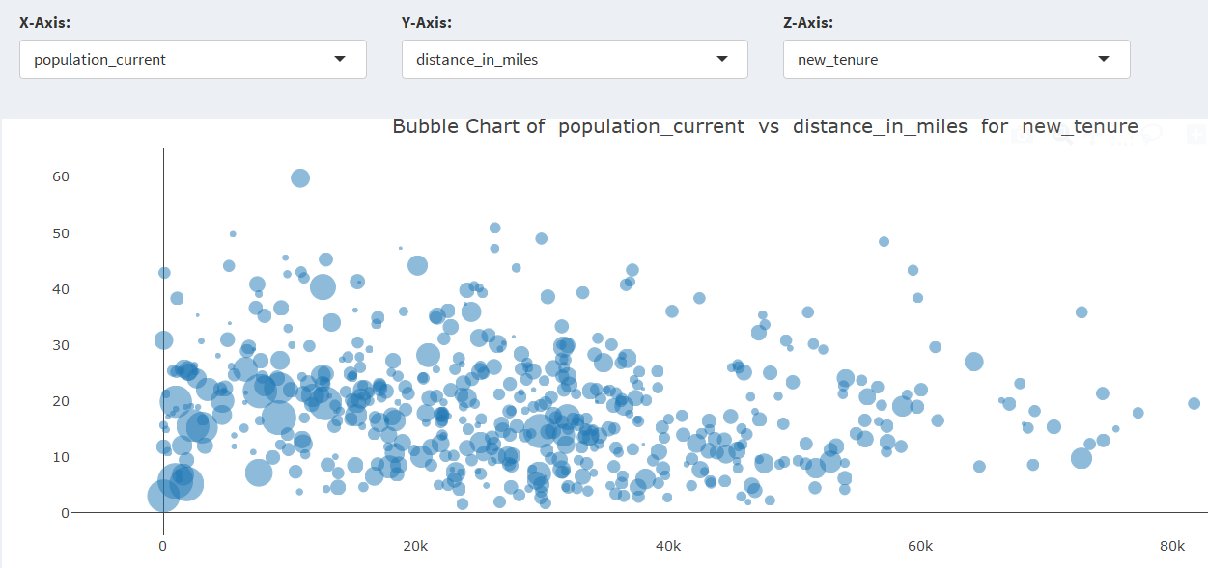
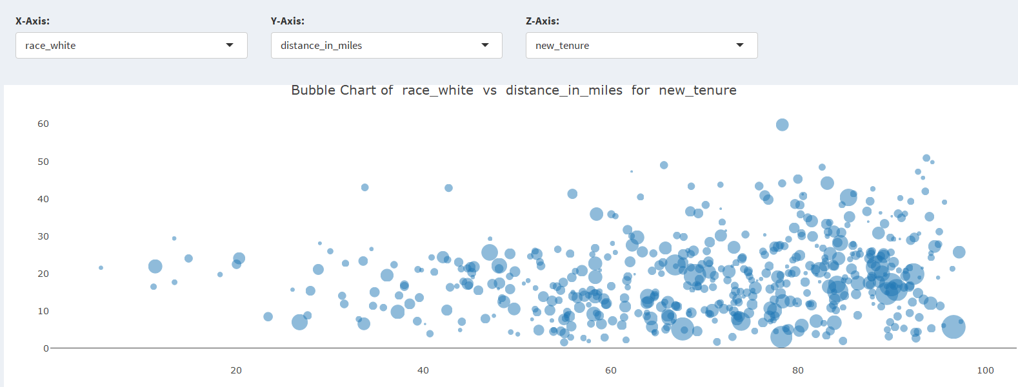
EDA & Insights
Higher Tenures are concentrated in zips with less population and less distant from office
Zips with high % of white people have higher tenures.

Slide 10
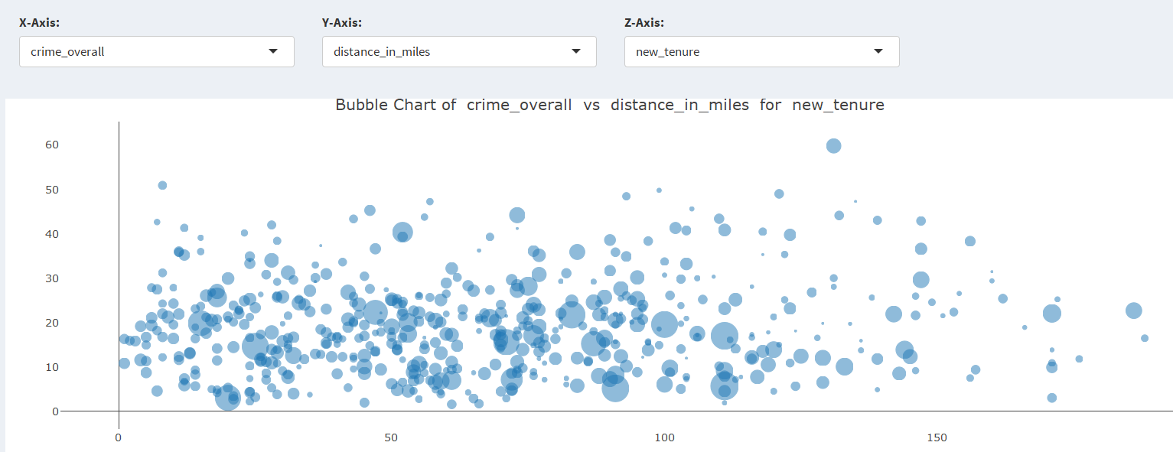
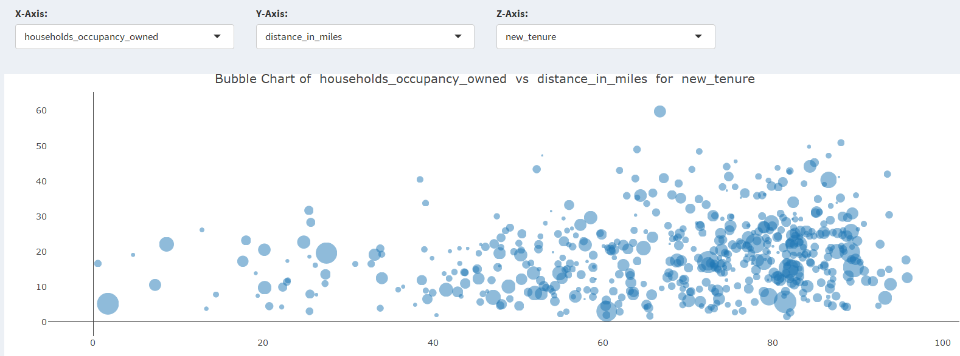
EDA & Insights
Zips with high crime rates don’t have high tenures.
Zips with high house ownership ratios have high tenures.

Slide 11
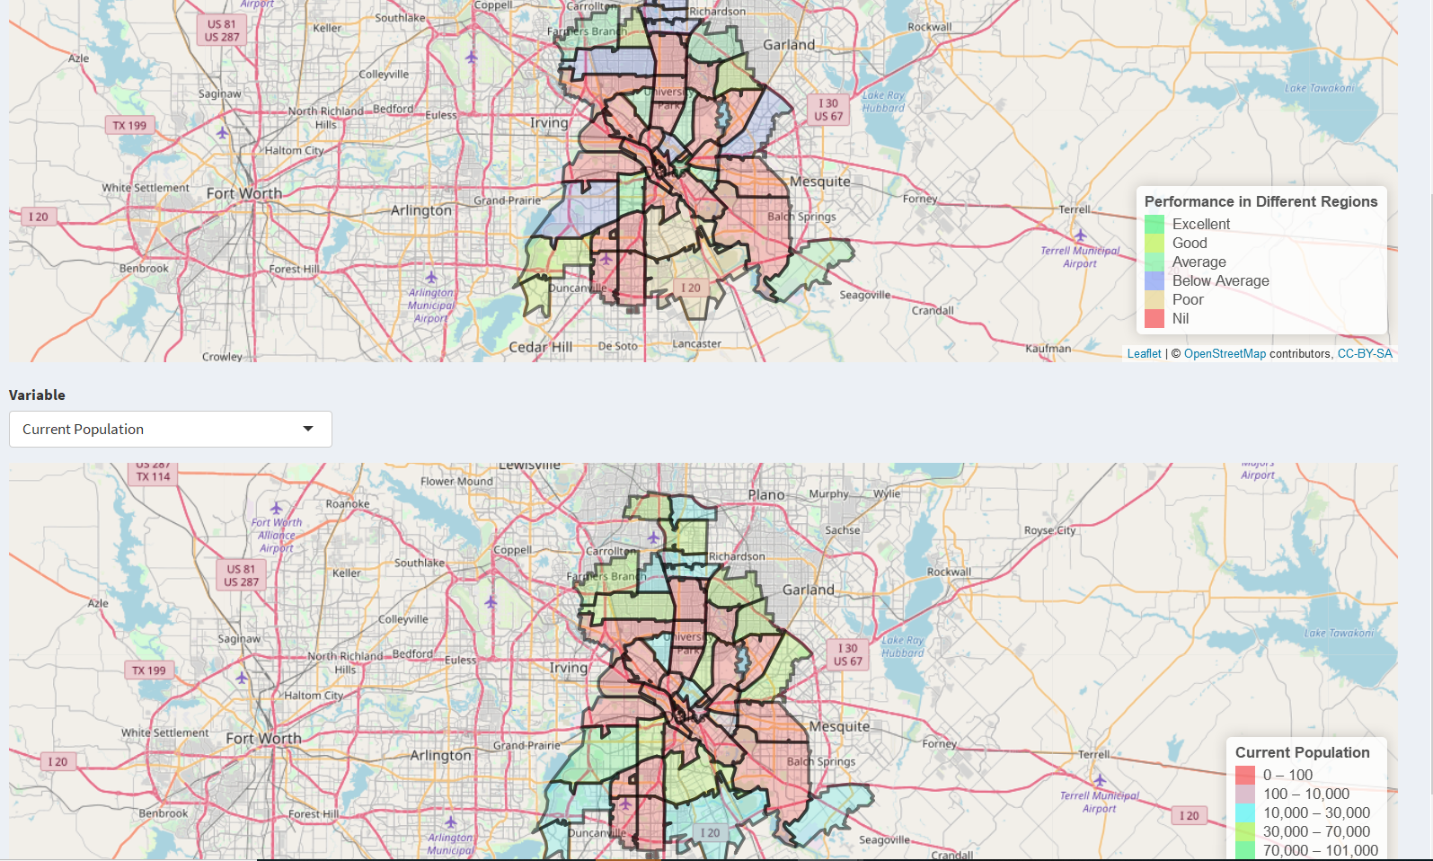
EDA & Insights
Zips with “Good” performance come from zips with population b/w 10k-30k

Slide 12
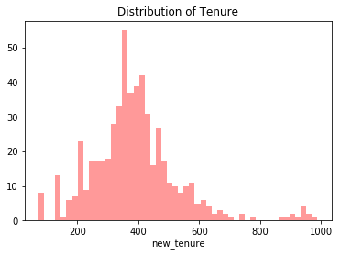
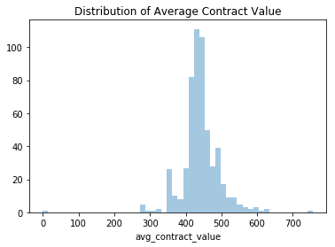
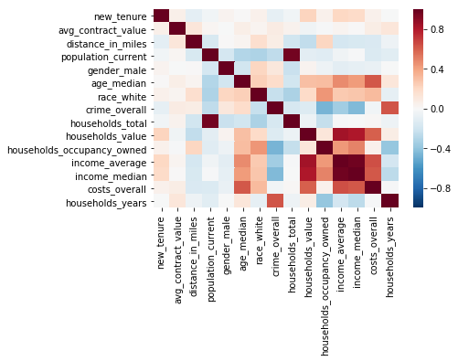
EDA & Insights
“crime_overall” moderate negative correlation with “household_occupancy_owned”, “population_current” and “income_average”/”income_median”
A strong positive correlation exists between “costs_overall” and “households_value”, “income_average”/”income_median”.
“age_median” is positively correlated with variables that determine the buying power of customer, like “households_value” and income.
Mean of tenure = 389, SD of tenure = 143
Little left skewed; almost symmetric
Mean of value = 441, SD of value = 53
Little right skewed

Slide 13
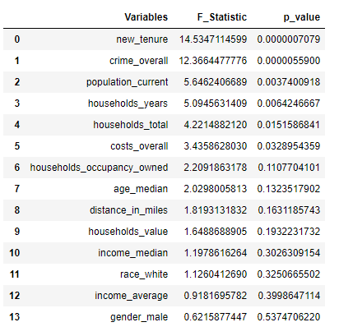
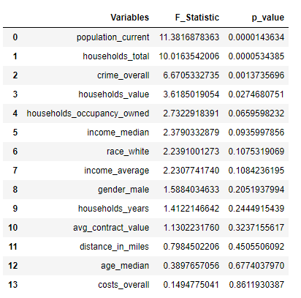
EDA & Insights
“new_tenure”, “crime_overall”, “population_current”, “households_years”,
“households_total” and “costs_overall” has impact on “avg contract value”
“population_current”, “households_total”, “crime_overall” and “households_value”
impacts “avg tenure”

Slide 14
Modeling Strategies: Next Steps
Regression (At zip level) – Regression models like Linear/Polynomial Regression, GAM, Regression Trees for predicting Avg Tenure & Avg Contract Value for each zip based on demographic data
Customer Survival Analysis (At customer level) - Finding average tenure for customers using survival analysis model; Cox regression etc.
Customer Lifetime Value – (Acq. Cost + Maint. Cost – Total Rev) for each customers
Data
Training – Zip-level aggregated data from 37 cities where Aptive has existing operations
Testing – Demographic data of the cities where Aptive is considering expanding to. Aggregate at city level to rank cities.
Cloud – AWS/Azure 16/32 GB RAM Linux VM needed for dashboard deployment

Slide 15
US Pest Control Dataset – Analysis and Recommendations

Slide 16
Problem Definition
As a new business in the Pest Control industry, it is important to identify its most profitable customers and areas with high customer pool vis-à-vis the areas with high customer churn rate and analyse the reasons for the same.
Key areas of concern:
Identify and target profitable customers and locations based on Customer Lifetime Values and demographics
estimate the value that you can derive from the customer
Identify customers who are likely to churn and focus on ways to retain them.

Slide 17
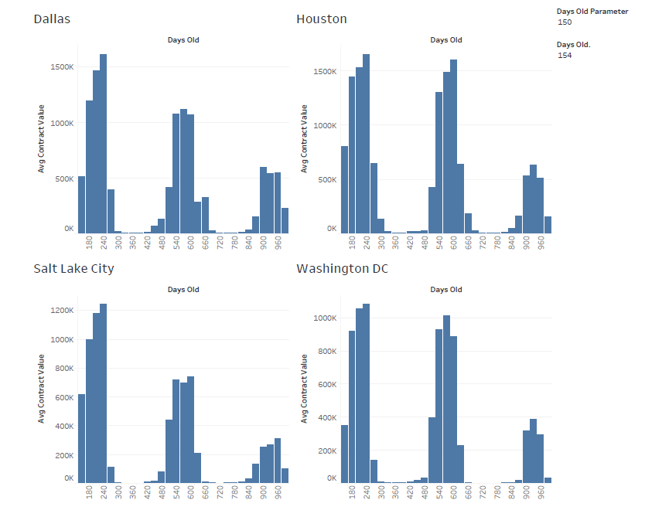
Pest Control Business Model
Majority of Door to door sales, cycle peaking during Summer from April- August.
Highest contract values are generated from the most recent acquisitions.

Slide 18
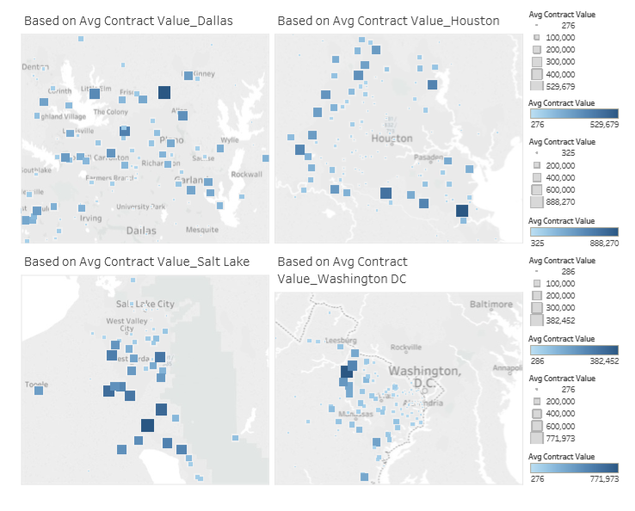
Geographical Spread – Heat Map Analysis

Slide 19
Recency Frequency Monetary (RFM) Analysis
Based on
Number of Customers (Recency)
Number of Services Completed (Frequency), and
Customer Lifetime Value (Monetary),
we identified the most profitable localities for the business to focus on
The following heat map indicates top 10% of the areas that contribute the highest to the revenue, thereby enabling the business to narrow down on these households in order to retain them:

Slide 20
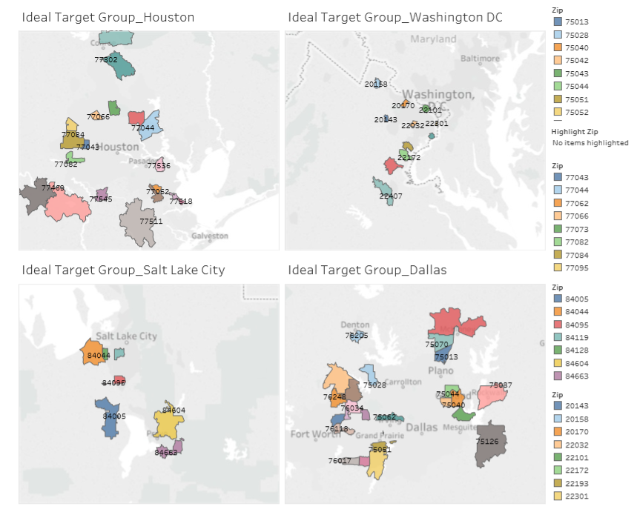

Slide 21
How to improve Customer Retention
The active customers with a Service Completion Percentage between 0.8 to 1 should be our focus as they have recently stopped availing the services.
Based on the data, major proportion of these customers have an average contract value in the range (300-400) and are in 210-300 days old (3rd Quarter) across all four cities
Therefore the business needs to innovate their strategies in order to retain this proportion of customers
Introduce invoice due alerts, discounts in advance to the 3rd Quarter to these set of customers.
Promote the business through cold calling these customers

Slide 22
Retention Analysis (snapshot)
Customers to be targeted from the retention analysis (snapshot)

Slide 23
Churned Customers
A prominent pattern of customers who cancel their services lie in the 489-671 days old and have contract values in the range of 300-500 across all four cities
Strategies to prevent churn during this period:
Introduce promotional offers like discounts and one-time free service to the customers with this kind of attributes well in advance
Contact the churned customers for feedback and focus on the area of improvement

Slide 24
Model Building - Summary
The classification algorithm yields similar results across all four datasets –
Algorithm used : Logistic Regression , Random Forest
Average Model Accuracy : 94.7%
Most Significant Variables : - completion percentage, - distance in miles, - average contract value, - difference
Other significant variables such as days old, median income, and households year built have strong correlation with the target variable and must be taken into consideration while taking business decisions.

Slide 25
Conclusion
The pest control business needs to primarily focus on the low performing regions where customer churn rate is high and work on promoting their services with attractive offers
In regions with high valued customers, the business needs to target the specific set of subscriptions that are most likely to churn and improve on ways to retain them – through promotions, improved reviews, additional services, etc.
As it is a seasonal business, the focus should be on optimizing their resources in order to improve their profit margins. From the above data modelling, an in-depth analysis on the most significant attributes affecting their business can help in identifying the key metrics to improve overall sales.

